Slide 1

Blinkit
India’s Last Minute App
Grocery Analysis

Slide 2


Introduction
Blinkit is leading online grocery delivery service in India, known for its lightning-fast delivery times. Formerly known as Grofers, the commitment to delivering essentials in the blink of an eye
Founded in 2013, Blinkit has revolutionized the way people shop for groceries by offering a wide range of from fresh produce to products, household essentials, right at your doorstep.

Slide 3

Business Requirements
To conduct a comprehensive analysis of Blinkit's sales performance, customer satisfaction, and inventory distribution to identify key insights and opportunities for optimization using various KPIs and visualizations in Power Bl.
KPI's Requirements :
Total Sales: The overall revenue generated from all items sold.
Average Sales: The average revenue per sale.
Number of Items: The total count of different items sold.

Slide 4

Visualization Requirement
1. Total Sales by Fat Content
2. Total Sales by Item Type
3. Fat Content by Outlet for Total Sales
4. Sales by Outlet Size
5. Sales by Outlet Location
6. All Metrics by Outlet Type

Slide 5
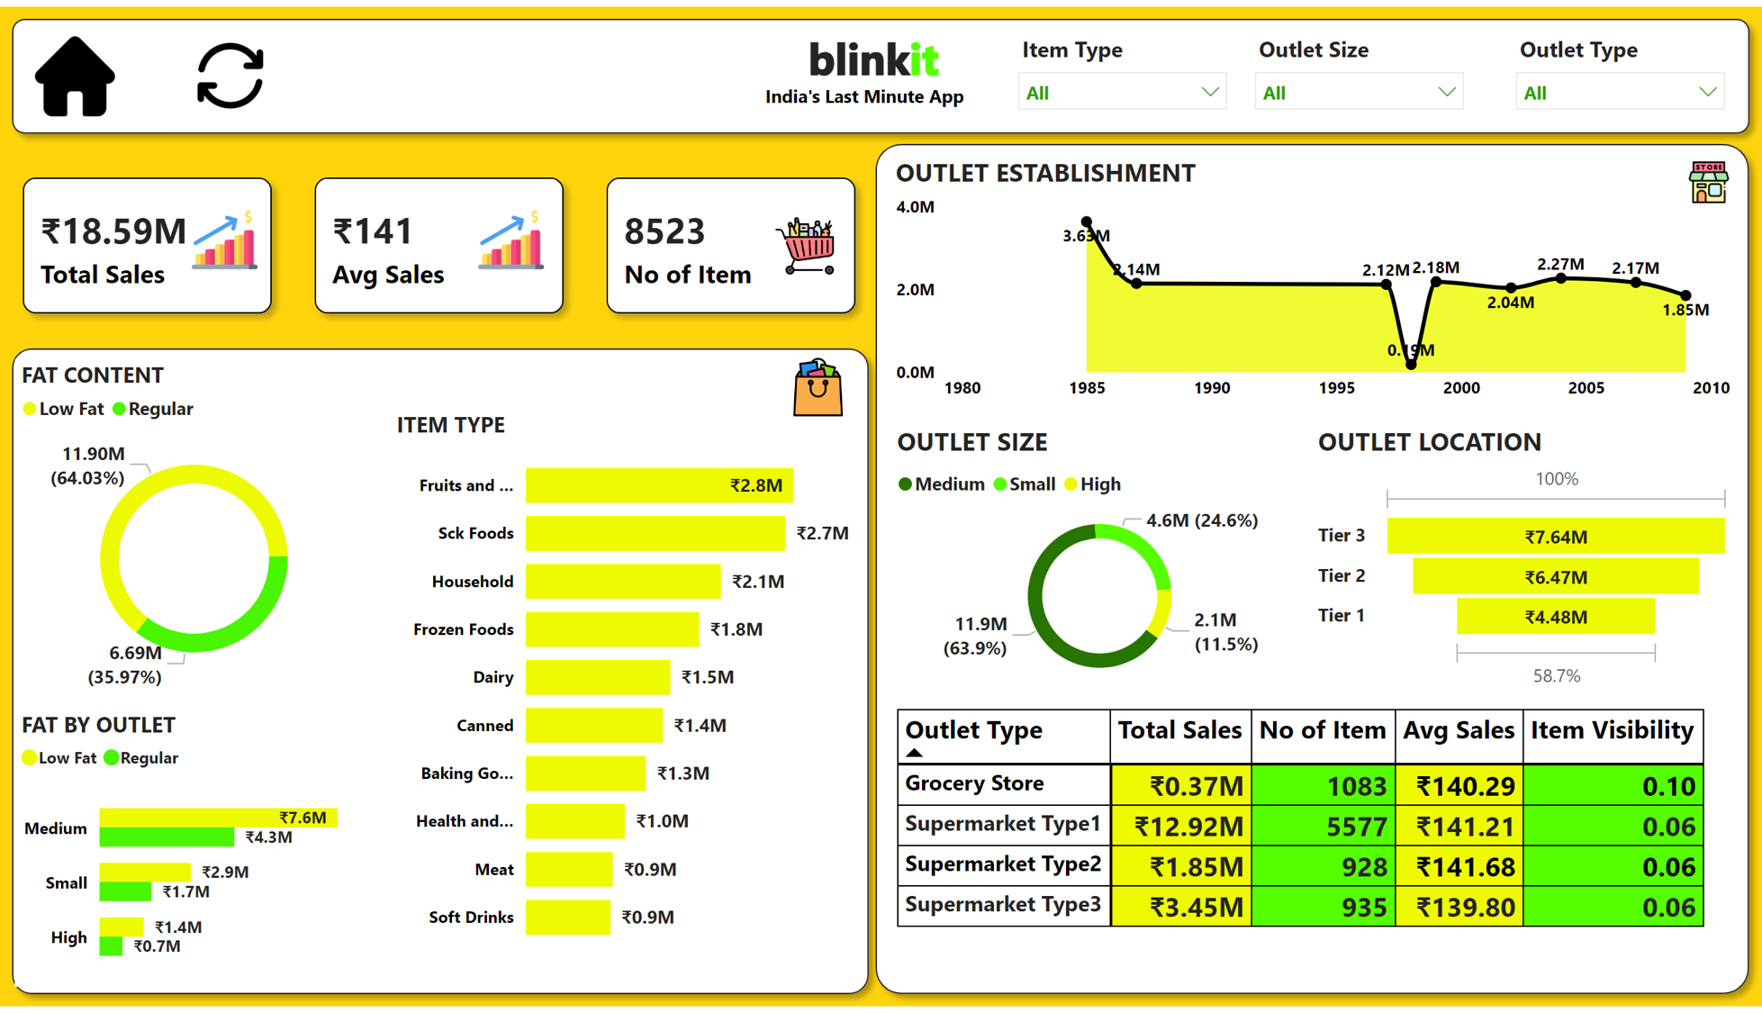
Dashboards

Slide 6
Findings
₹ 2.8 M
Fruits and
Vegetables are Top Selling
Total Sales: ₹ 18.59 M
Average Sales Per Items: ₹ 141
No of Items: 8523
₹ 7.64 M
Tier 3 locations have the highest sales
₹ 11.90 M
Low Fat content are preferred more
₹ 1.85 M
Total Revenue
In 2009

Slide 7
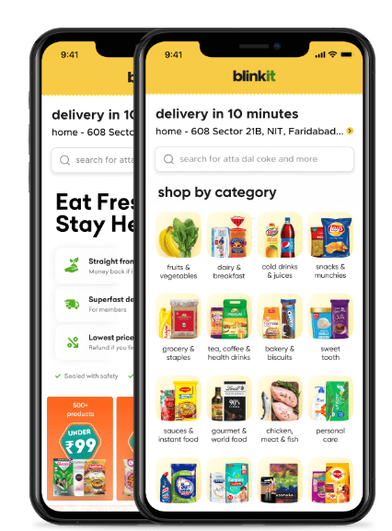
Conclusion
The business is performing well with over ₹1M in total Sales.
A strong consumer preference for low-fat products indicates health-conscious buying habits.
Fruits and vegetables, snacks and household are the most popular categories, suggesting opportunities for expansion or promotion in these areas.

Slide 8

Thank You

